Slide 1


2023 Orientation programme for New Students

Slide 2


Accounts Receivable automation at UNIVEN success story
Why other receivables
What informed the request – Challenges
What are the benefits
Accounts Receivable functionality
Process of automation

Slide 3
Why other receivables
Effective management of Accounts Receivable/other receivables contributes to 3rd income stream revenue pot
Other receivables at UNIVEN refers to sundry debtors, sponsorship receivables, grant receivables, staff housing receivables, rental of facilities , other deposits etc

Slide 4
AR Automation
Use technology and automation to streamline Accounts Receivables processes and improve efficiency.
AR automation to boost the recognition, measurement, and write-off of receivables, as well as factoring and discounting.
AR collection techniques to drive cashflow

Slide 5
Challenges relating to Manual Processing of the AR
Cumbersome manual processing and issuance of invoices outside the ERP/ITS
Invoice sequencing challenges
Decentralisation of invoices
Non-compliant invoices
Recurring audit findings
Non-compliance with IFRS – Cash vs Accrual accounting concept
Non-compliance with VAT

Slide 6
Issuance of Invoice
Offers an online request invoice form
Development of debtor database
Creation of a debtor database that contains all required biographical and statutory information
Assists in follow-up on debtor accounts to identify “at risk” clients to prevent prescription
VAT Compliance
VAT accounted for at a point of issue
Offers option to choose and add line items for vatable, exempt, zero rated or partial VAT
IFRS Compliance
At the point of issuing an invoice , income is recognised and receivable raised
Both Income and Receivable account no longer understated
invoices emailed directly to the requestor
Invoices archived and can be retrieved and reissued at any given point
Assists in proper sequencing
Data available for other receivable ECL calculation

Slide 7
Accounts Receivable functionality combined with the above
Issuance recurring invoices (Rentals, repeat monthly services)
Issuance of statements
Development of debtor database
Invoices and statements issued to a nominated email address

Slide 8
Further Benefits of AR solution
Ability to analyse individual debtor performance- debtors aging report
Assist in measurement of sundry debtors for AFS
Eliminate the unknown receipts on suspense accounts due to referencing challenges
Uniform formatting
Encryption to prevent invoice “tampering”
Issuance of ad-hoc (Grants and once off payments)

Slide 9
Process of automation
Lessons Learned
Before implementation, verifying of existing data on the accounts revocable subsystem is vital as this would ensure that business operations. (GL and TT Clean Up)
These would include general ledger accounts, transaction types as well as the debtor’s database to ensure accurately
Challenges
Emails not being sent to alias email account invoice.billing@univen.ac.za
Linking of debtor (internal) to the payroll subsystem (if this a staff debtor)

Slide 10
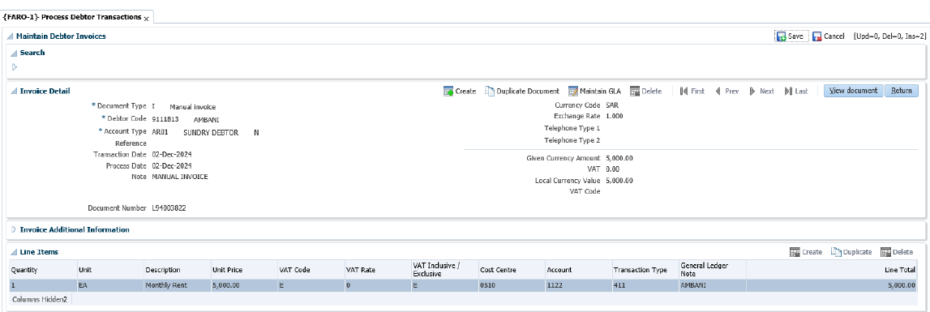
Accounts Receivable Functionality
Processing of Invoice

Slide 11
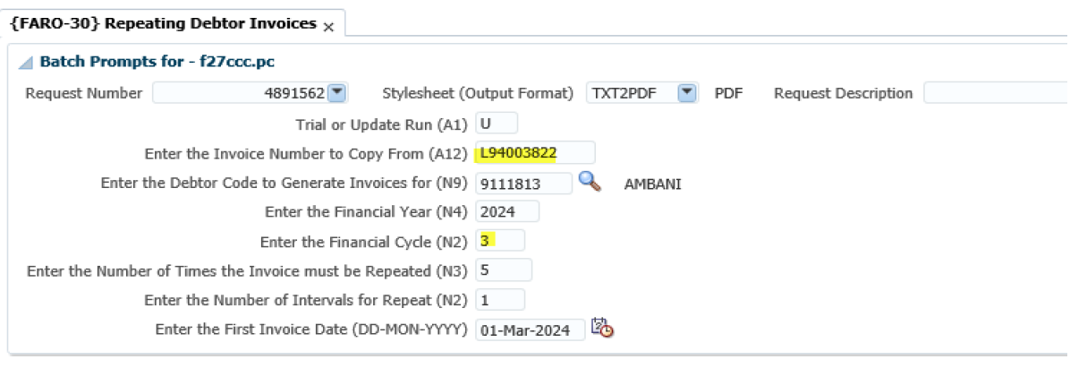
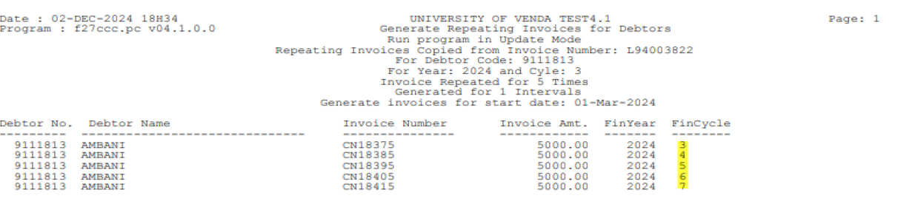
Accounts Receivable Functionality
Processing of Repeat Invoice

Slide 12
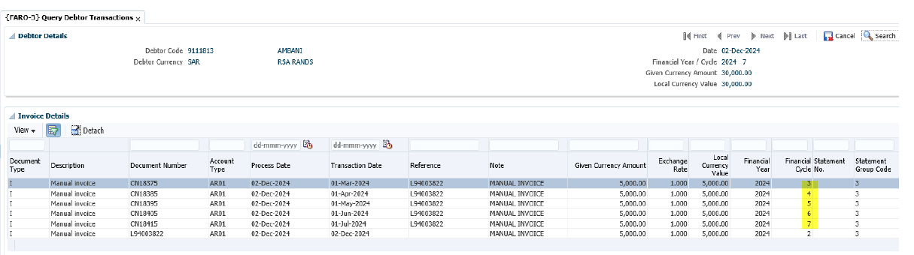
Accounts Receivable Functionality
Analysis of Repeat Invoice

Slide 13
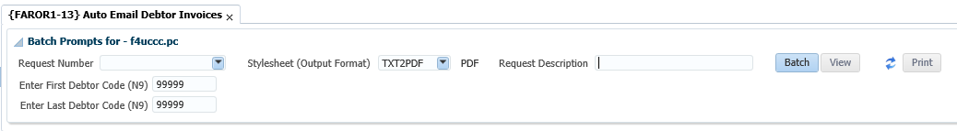
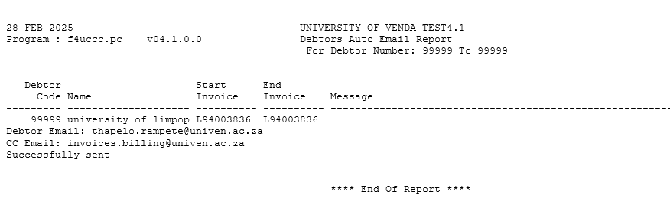
Accounts Receivable Functionality
Mailing of Invoice
Auto Email Debtor Invoices are processed in FAROR1-13
Output If Invoice Successfully Sent

Slide 14
Accounts Receivable Functionality
Mailing of Invoice
Output If Process Failed

Slide 15
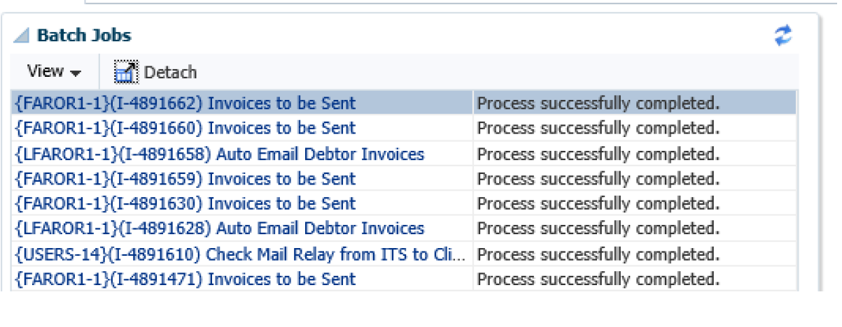
Accounts Receivable Functionality
Mailing of Invoice on a batch process

Slide 16
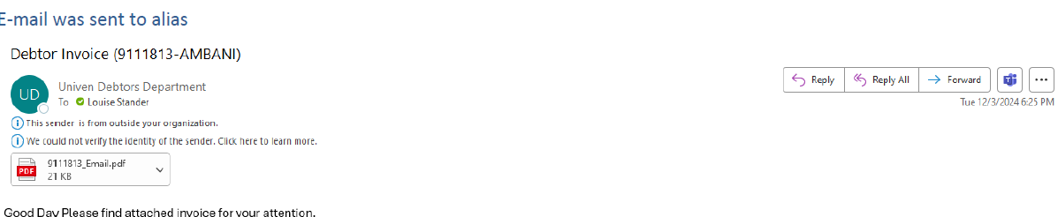
Accounts Receivable Functionality
Mailing of Invoice
Example of Email Received to Alias Email

Slide 17
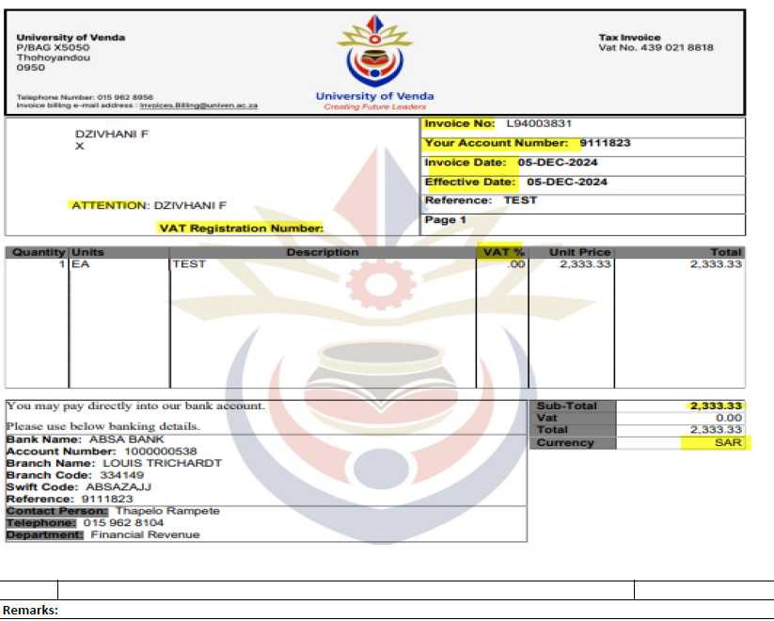
Accounts Receivable Functionality
Uniform template usage

Slide 18


The end

